Slide 1
Week 10 – Inputs
AACS2192 Analysis and Design of IS – Case Study
Library System

Slide 2
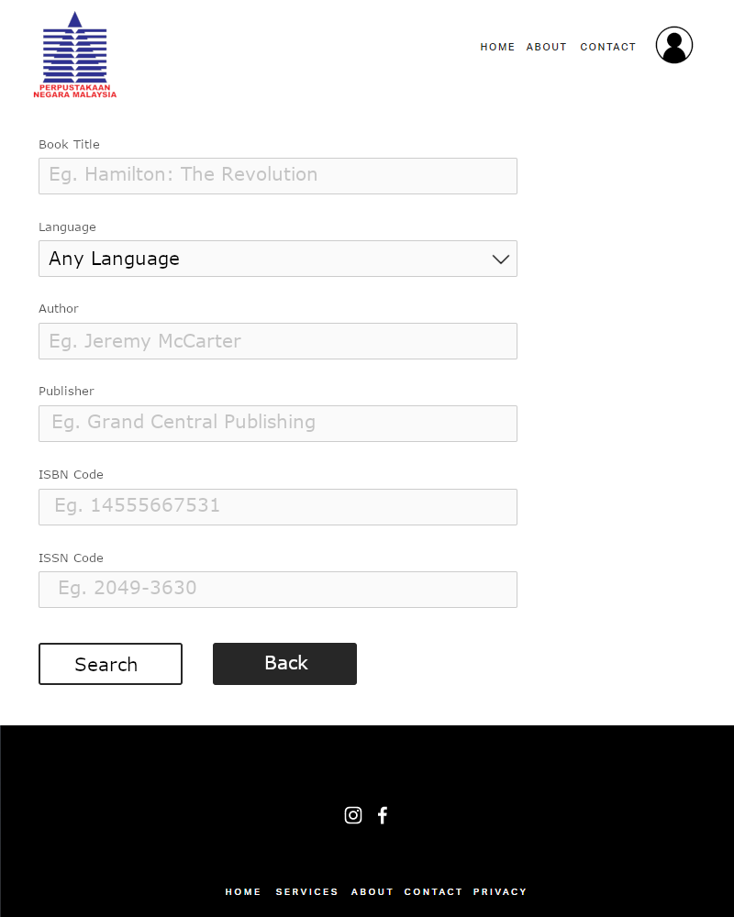
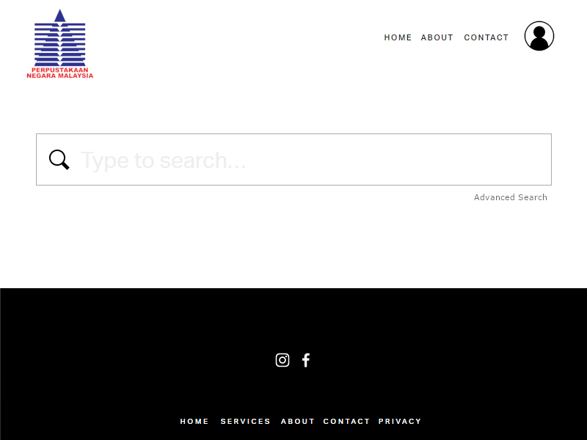
Advanced Search Page
Search Page

Slide 3
Characteristic HELP Facilities
This is a search page for the National Library of Malaysia. It contains a hypertext in a box. This can help when users are unsure or unable to perform a certain function or made an error and it also accompanied by an example application of the command. Before user key in data it will suggest a correct alternative to the command that the user has specified.

Slide 4
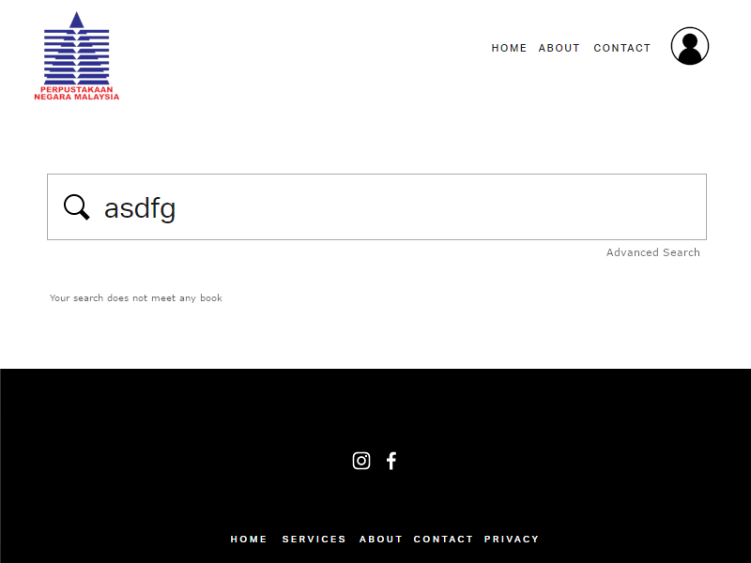
Search Page (Validate inputs)

Slide 5
Data Validation Existence check
The book of user wants to find is checked for the existence in library. If the book does not exist in library, it will display an error to inform user and if the book is existing it will display the book information for the user.

Slide 6
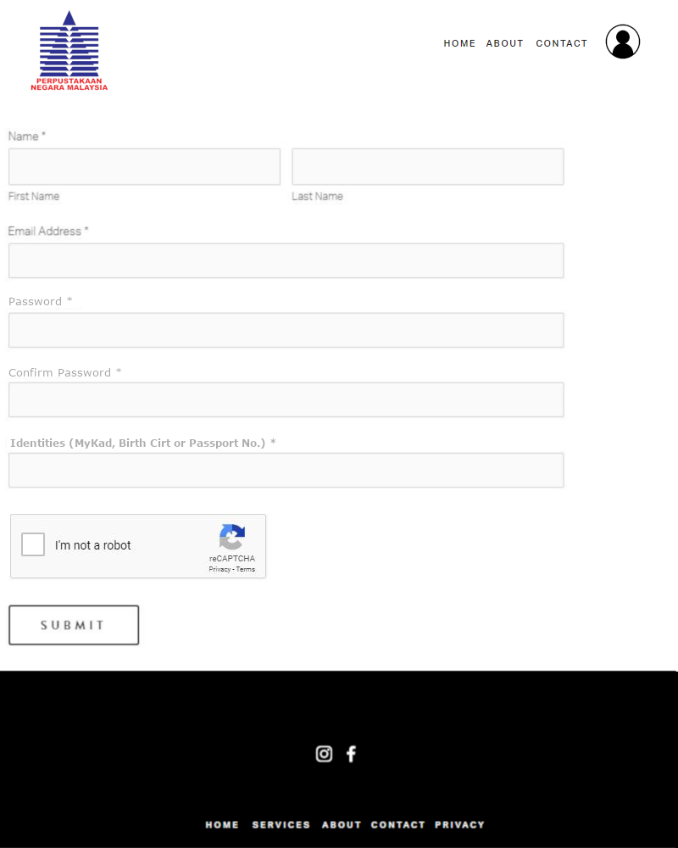
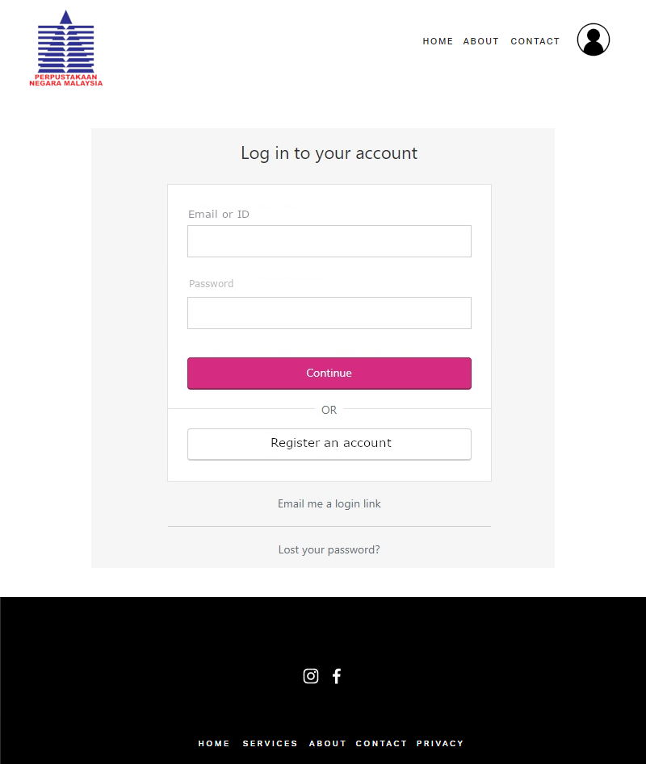
Register Page
Login Page

Slide 7
Characteristic Ease of Data Entry
This is a login and register page for the National Library of Malaysia. The data entry screen in the same logical order as the input form. After that it also have a clear title of field and if user insert an invalidation data it has a provision of data validation checks in order to reduce potential human data entry error.

Slide 8
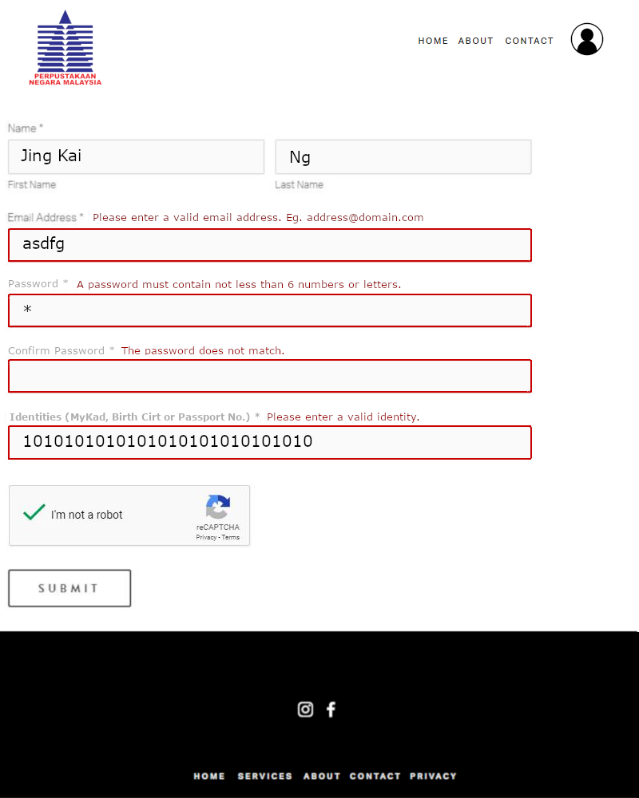
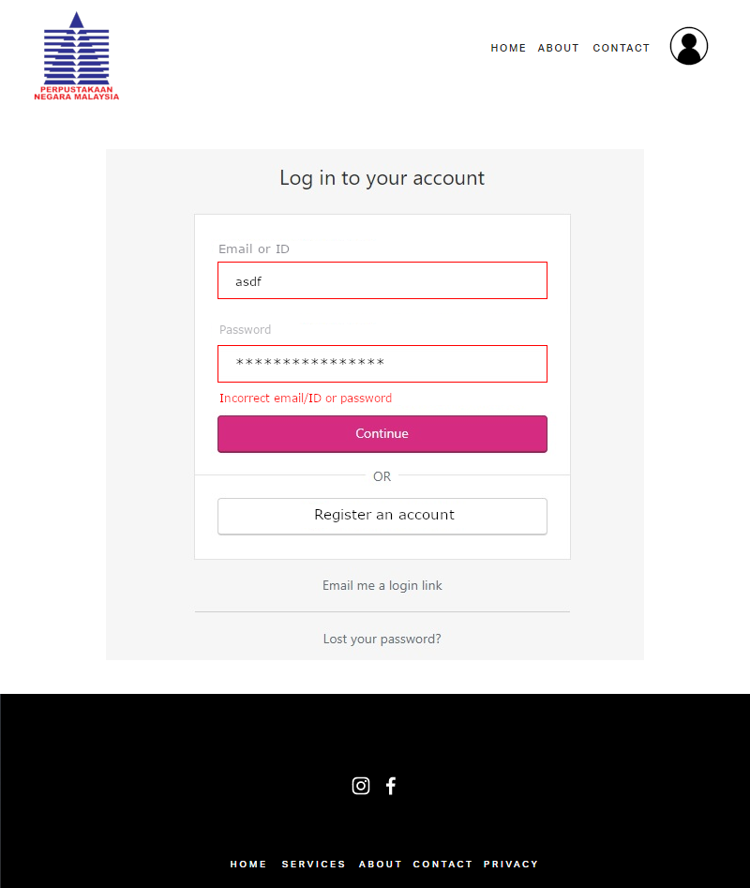
Register Page (Validate inputs)
Login Page (Validate inputs)

Slide 9
Data Validation Data Type check
No digit and symbol in the name check. No alphabetic data in identifier check.
Format check
Use to check email format such as xxx@gmail.com

Slide 10
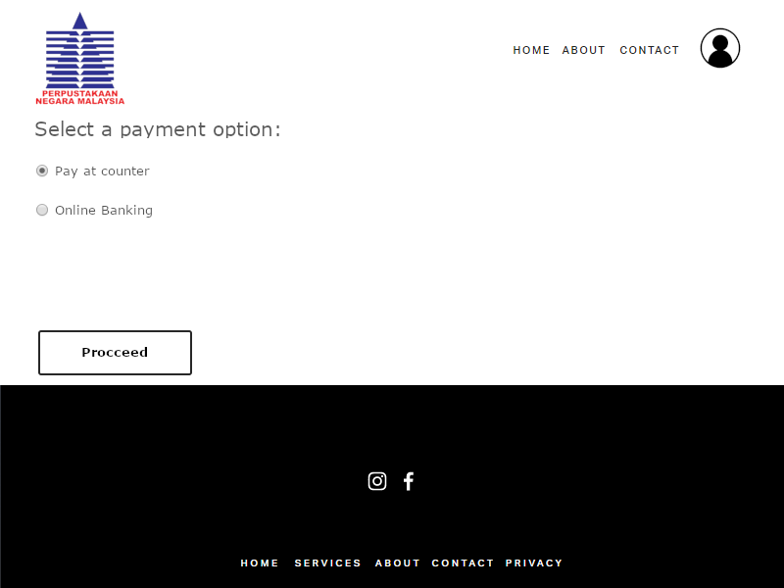
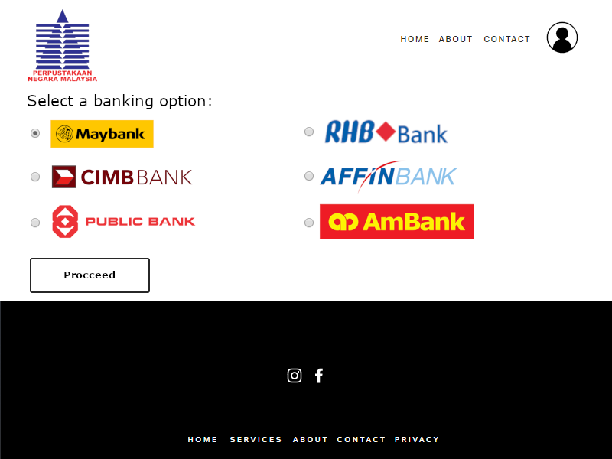
Payment Option Page
Banking Option Page

Slide 11
Characteristic Default Value
The default value is set as an option, so if the user does not make an option, the process will continue to the default option.
Data Validation
Range check
No multiple options in the payment option check.
Presence Check
Cannot leave the options empty

Slide 12
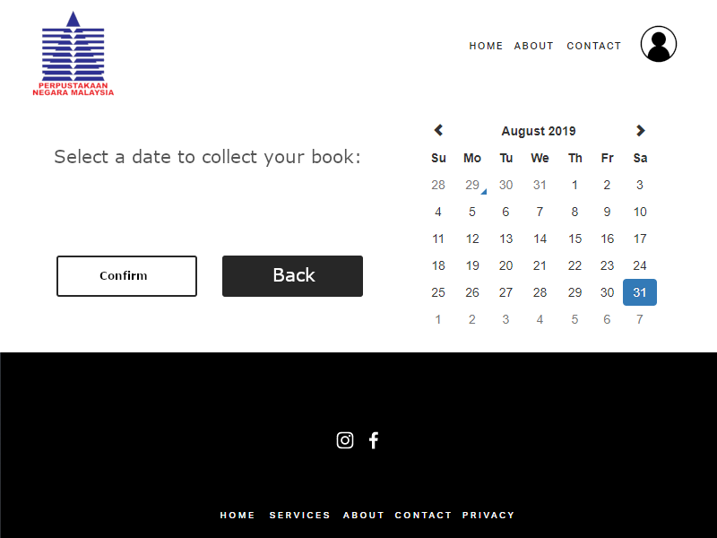
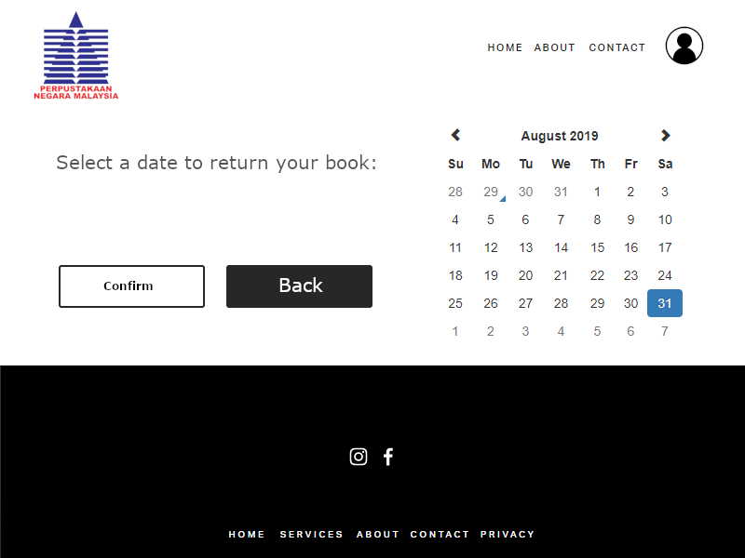
Collection Date Page
Return Date Page

Slide 13
Characteristic Date picker
This is the collection date and return date page of National Library of Malaysia website. The user interface displays a date drop down list for user to click on a date. The date picker user interface replaced the date format which is confusing. E.g. 2/3/2012, 2 March 2012, or March 2 2012.

Slide 14
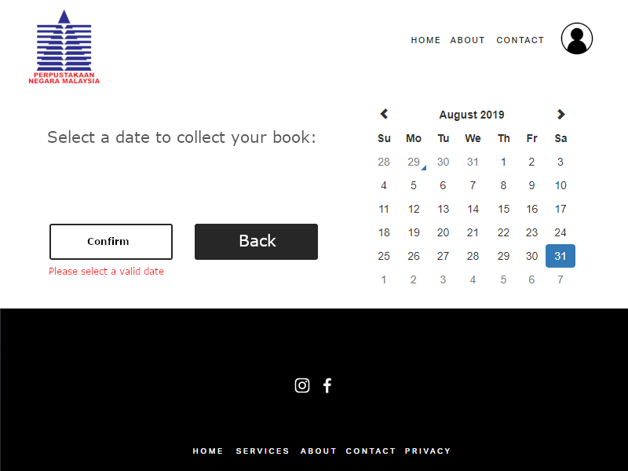
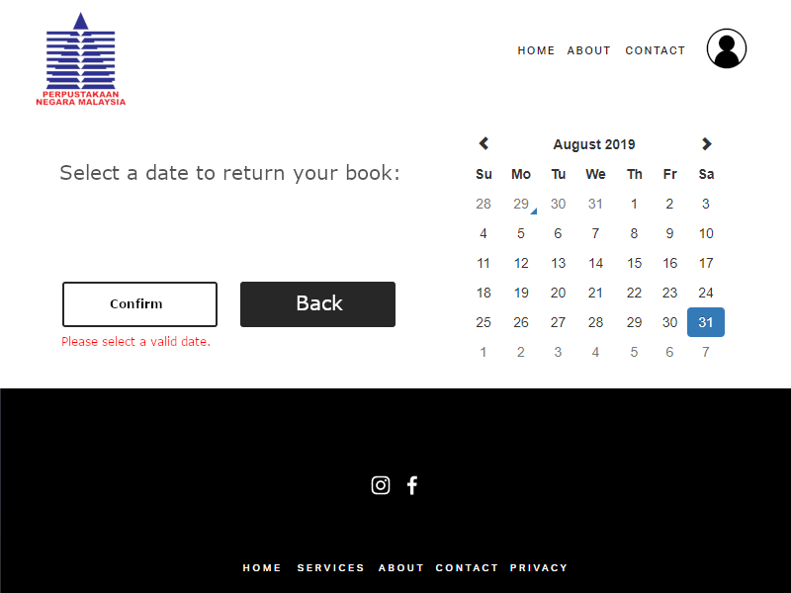
Collection Date Page (Validate inputs)
Return Date Page (Validate inputs)

Slide 15
Data Validation Range Check
Restricting date ranges such as only after today and not more than two weeks can only be chosen.
Data Type Check
Only date type can be entered to this user interface.

